Slide 1
Fourier terms for TS seasonality (harmonic regression)
Juan Garbayo
Forecasting & Time Series Analysis – 2022/2023

Slide 2



01
Problem statement
02
Linear independence
03
Example – Quarterly data
04
Examples in R
02

Slide 3
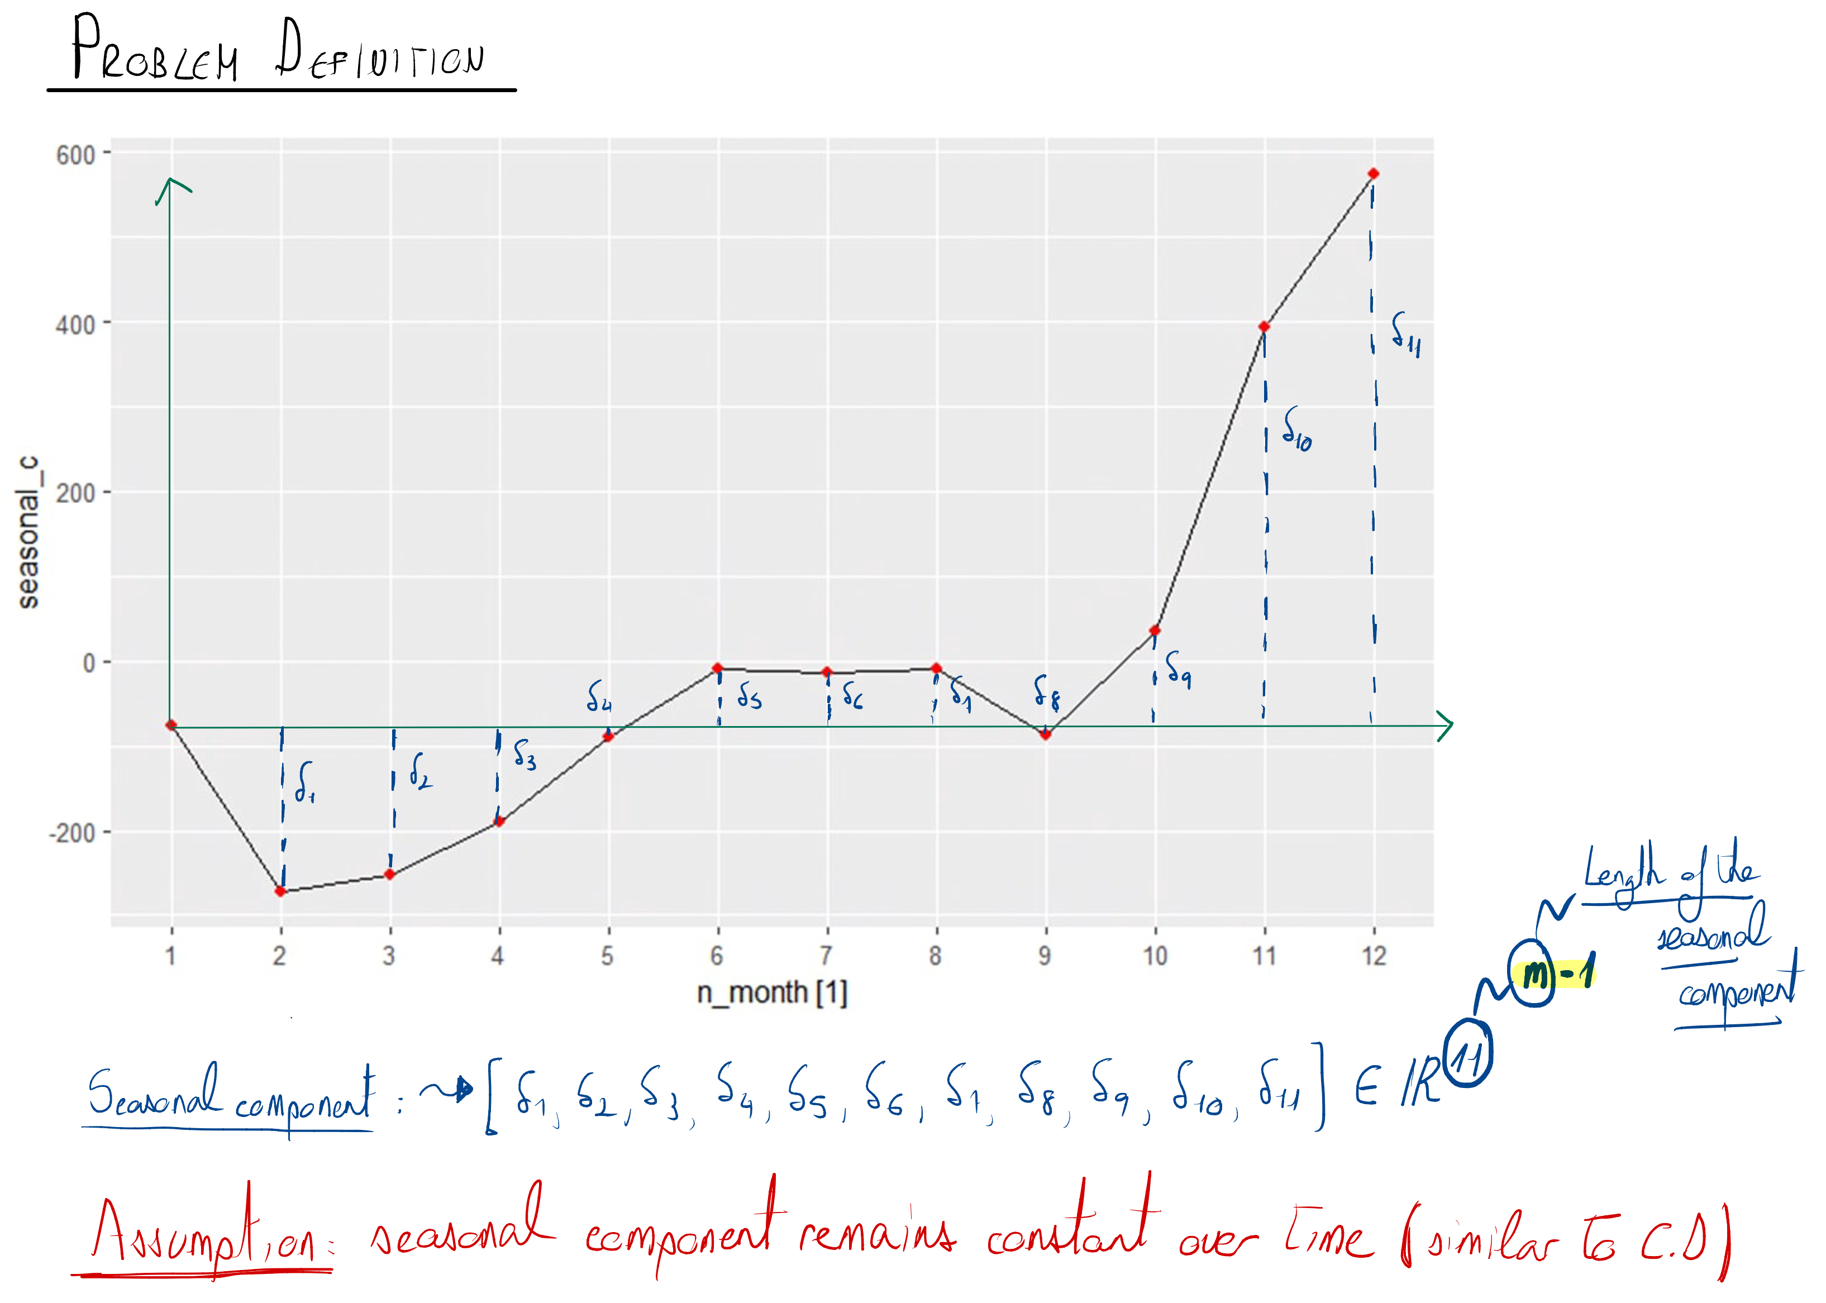

Slide 4
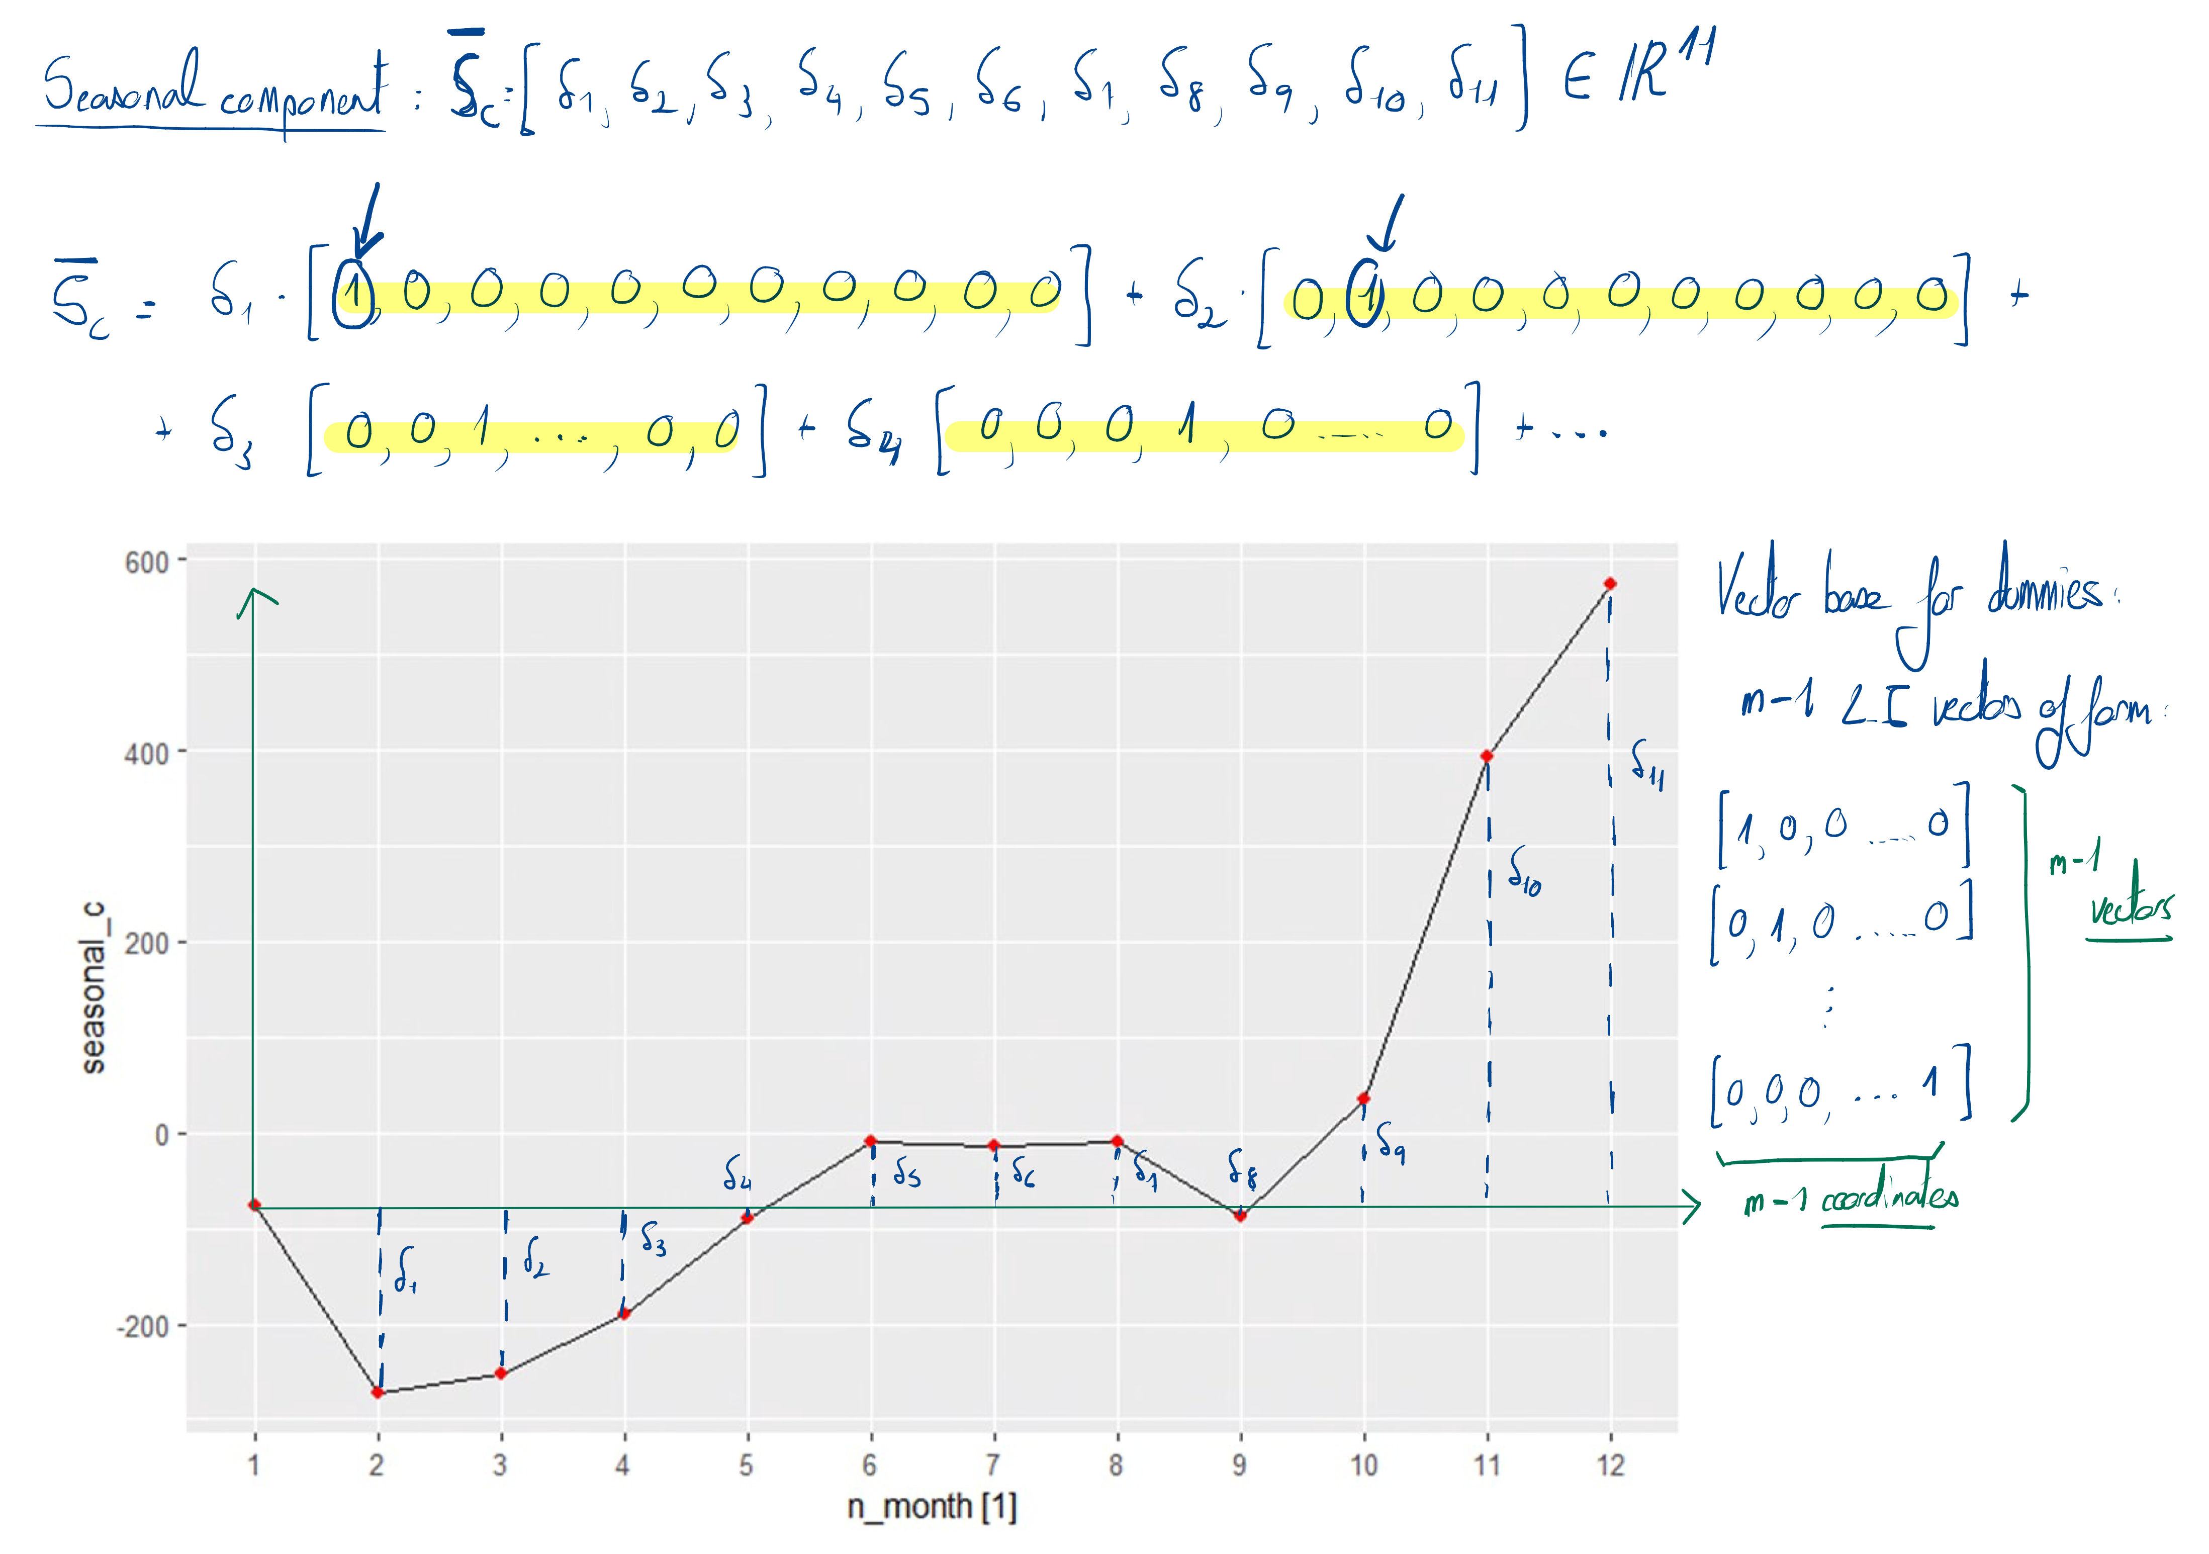

Slide 5
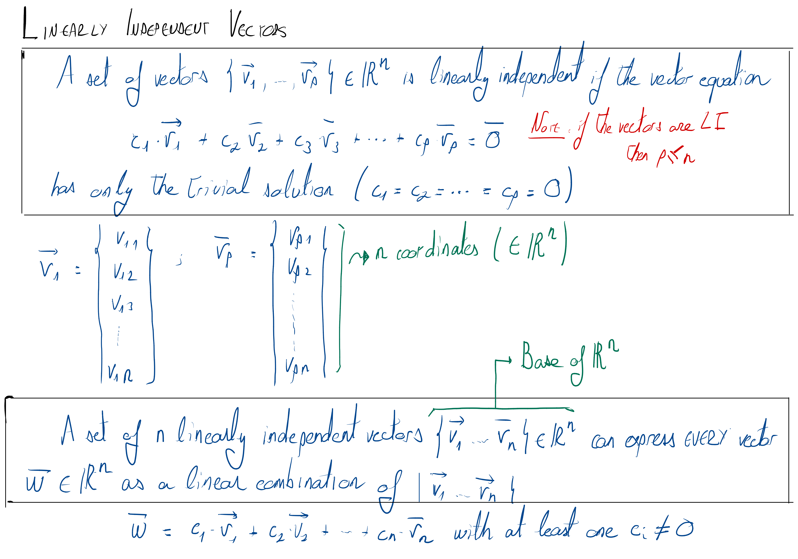

Slide 6
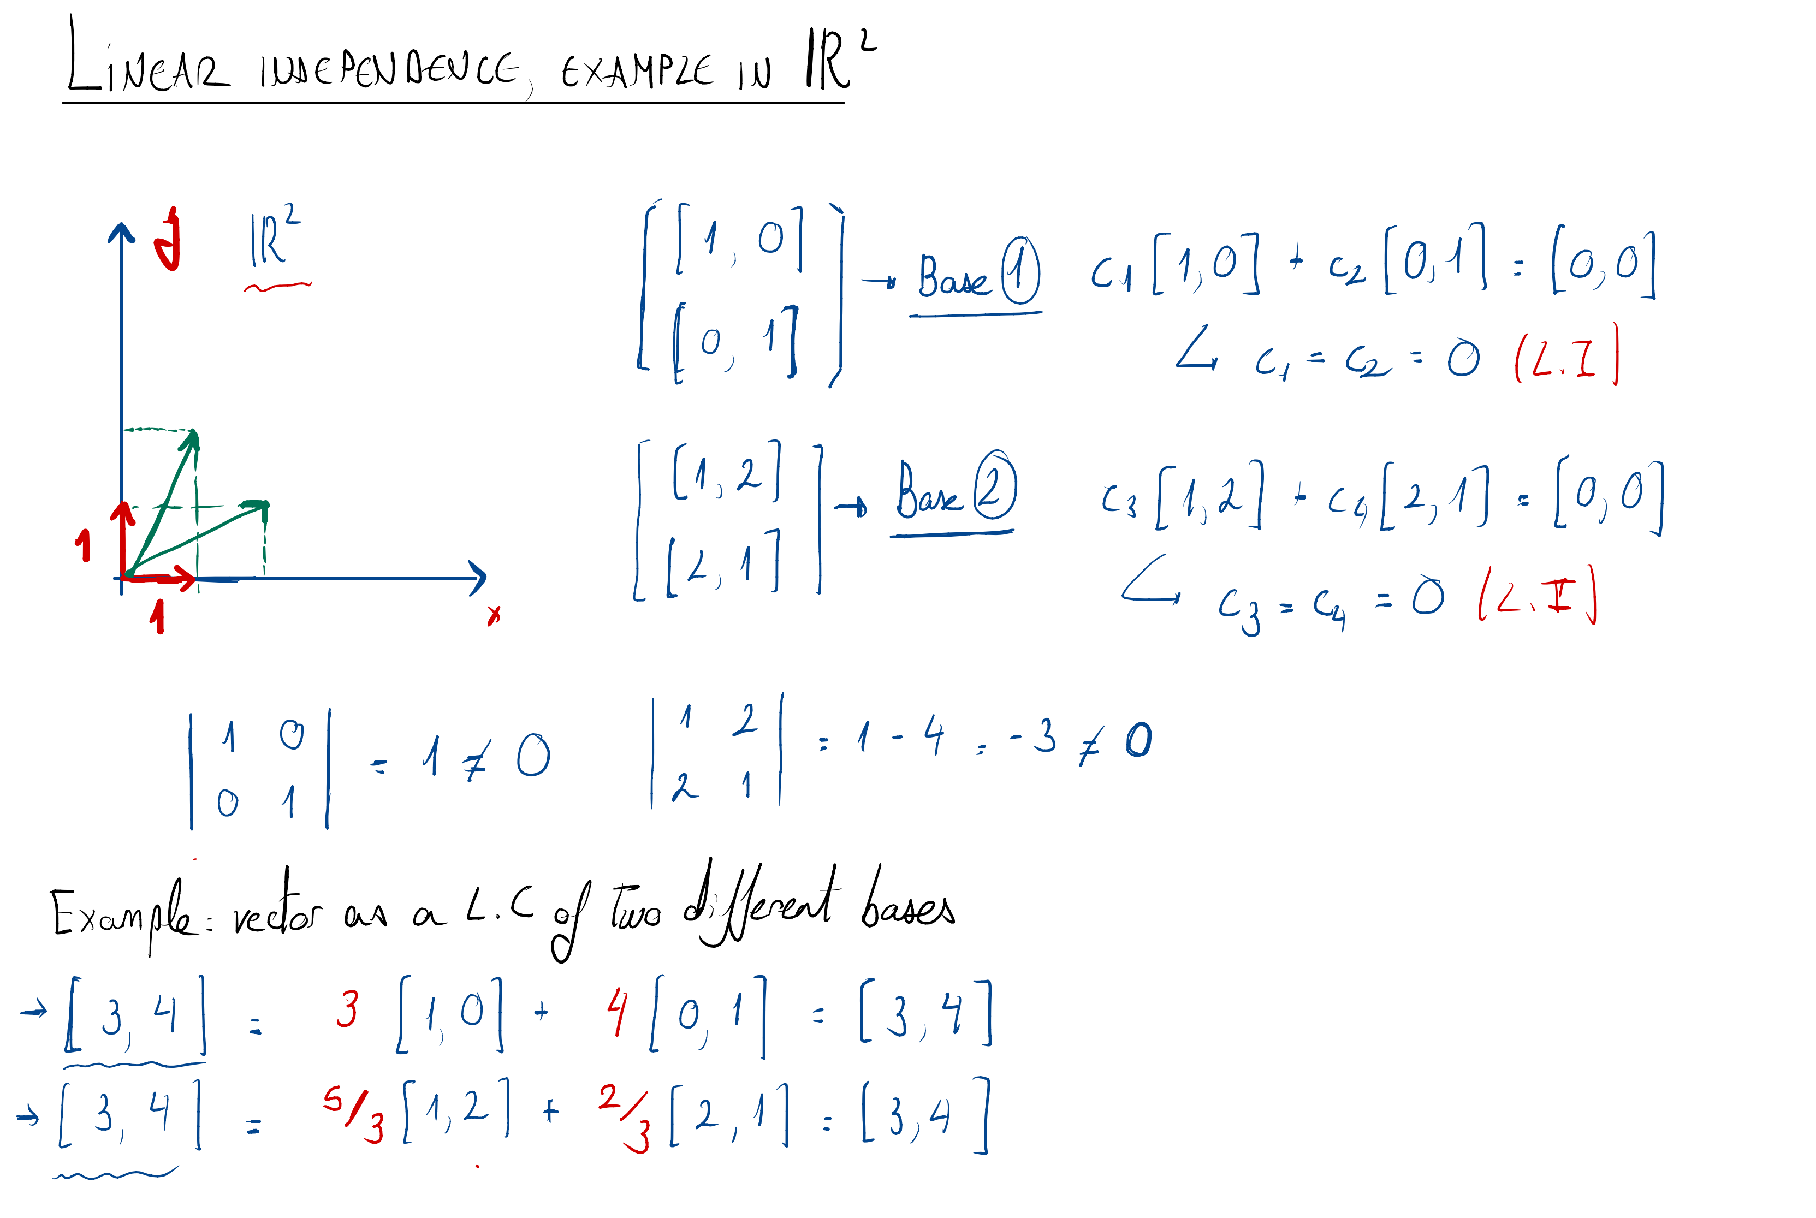

Slide 7
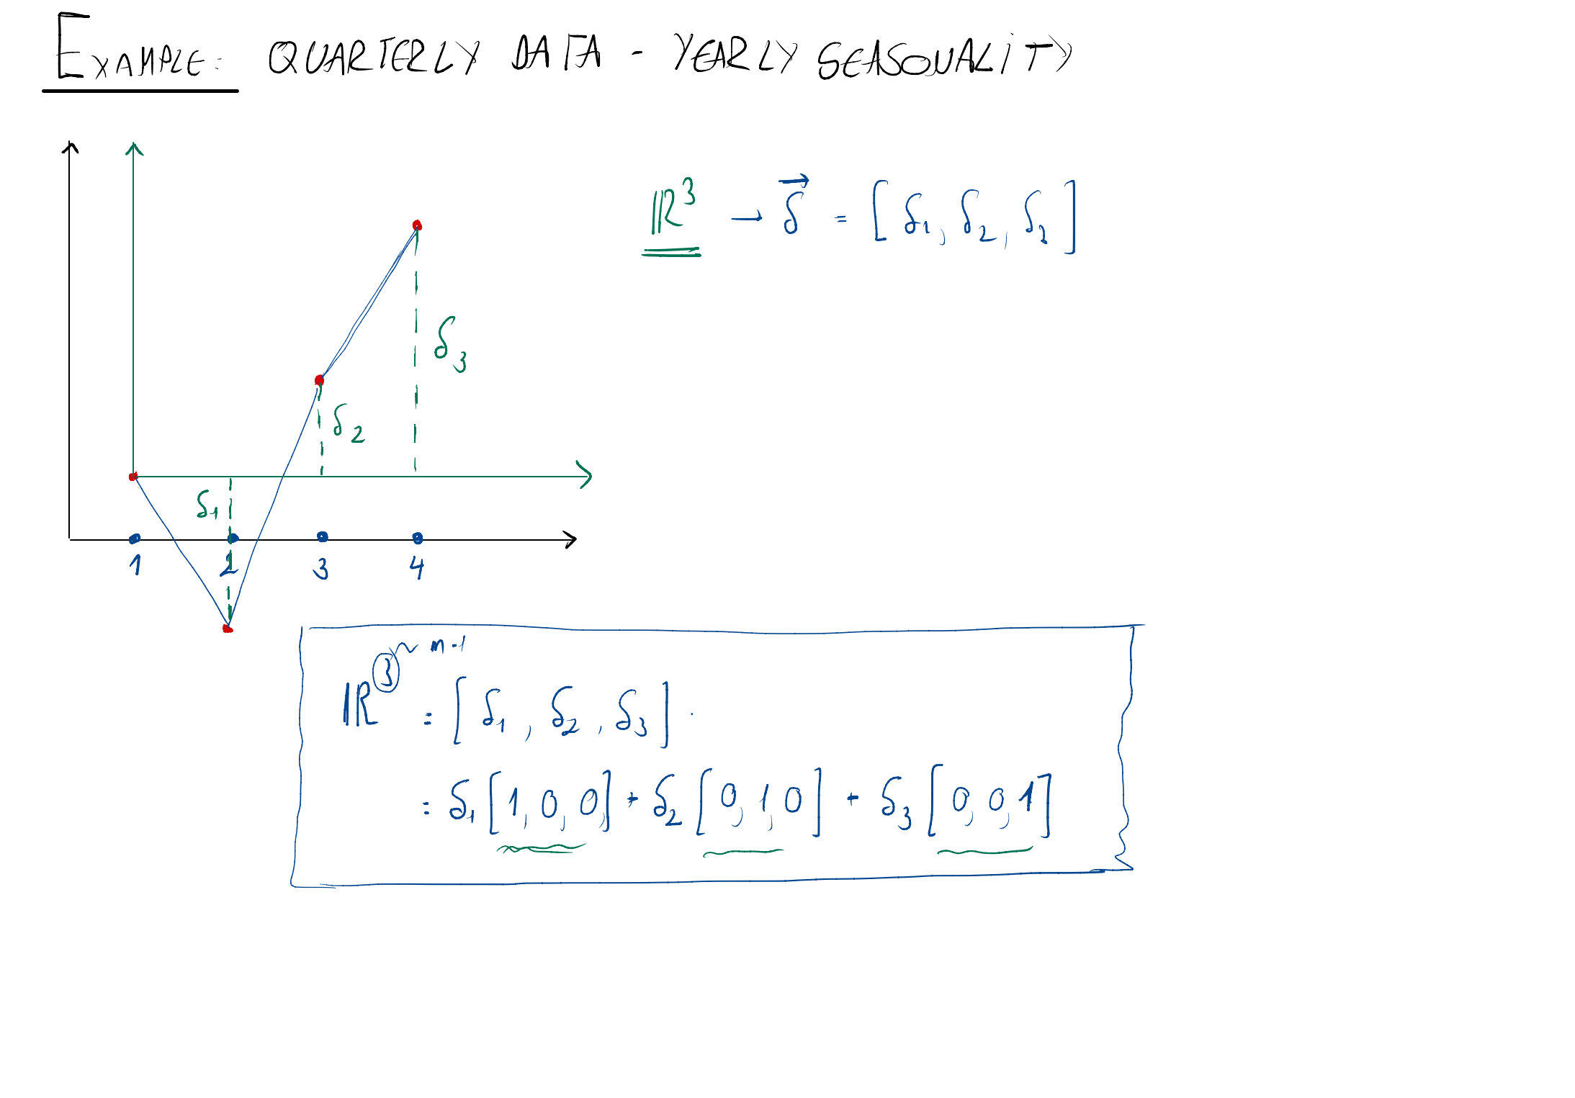

Slide 8
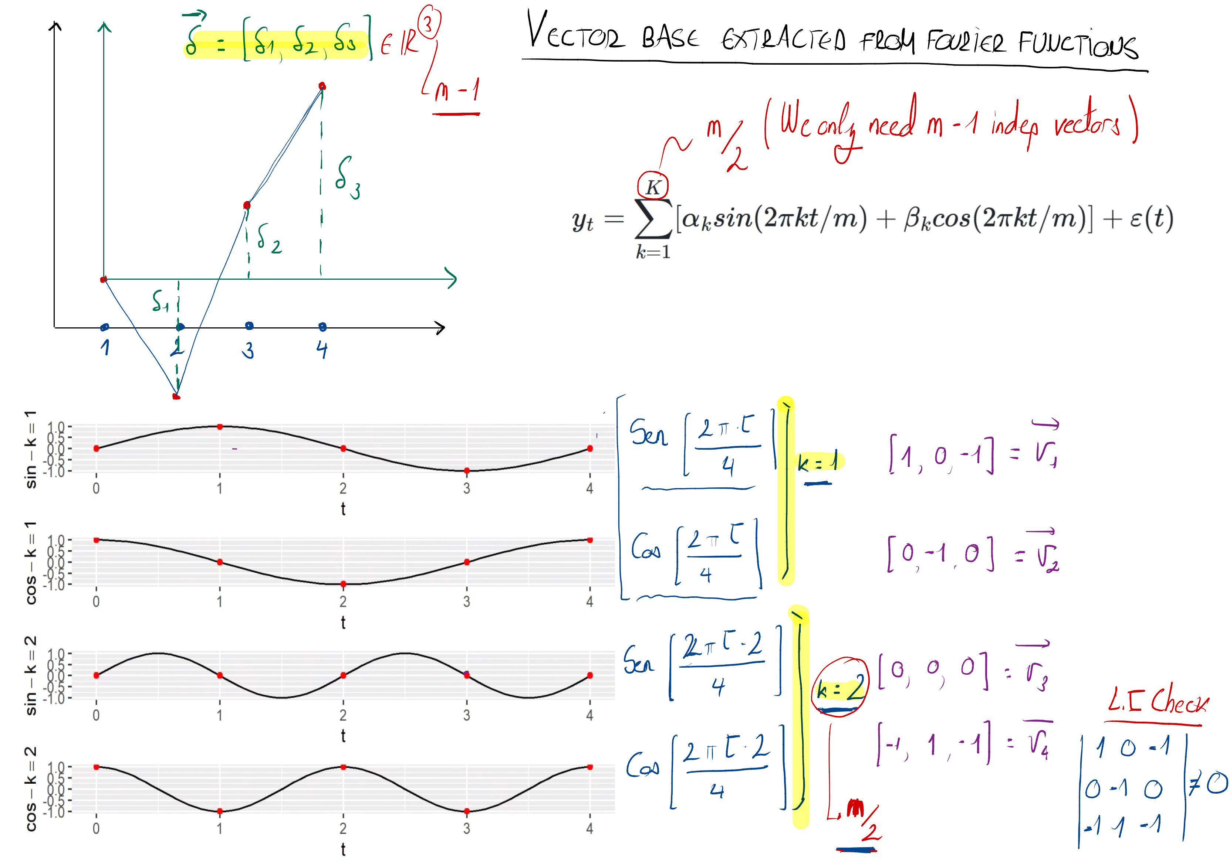

Slide 9
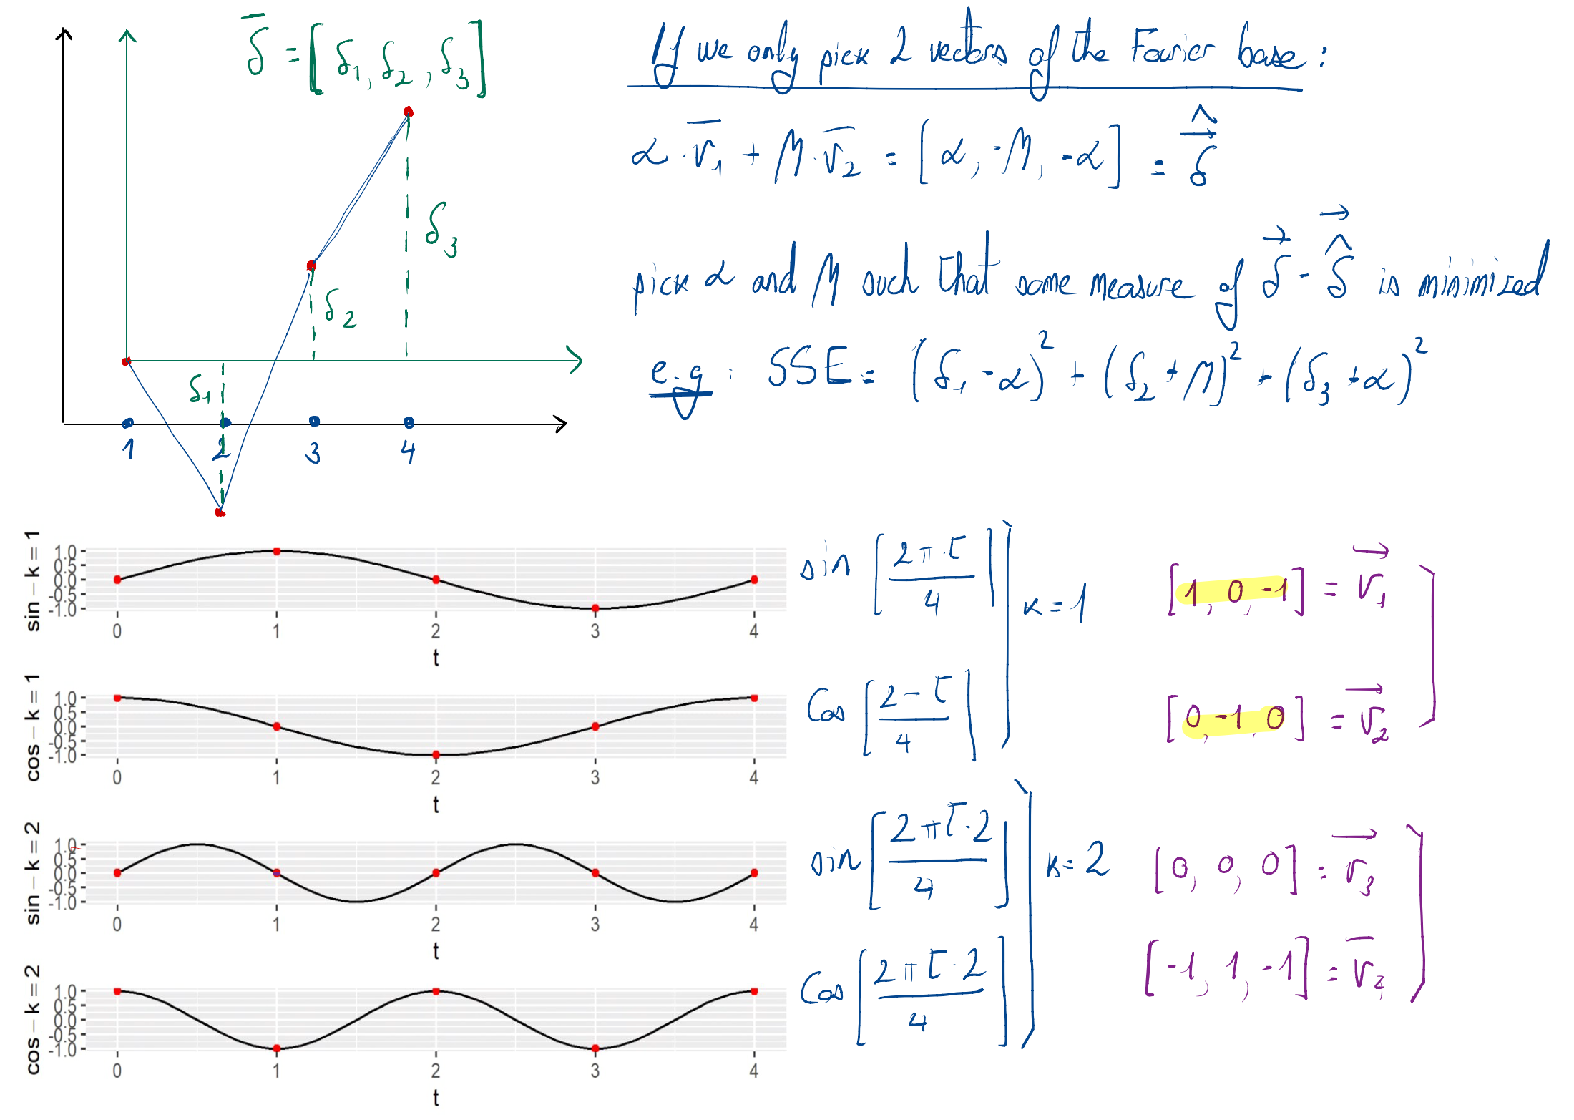

Slide 10
Examples in R – see video lesson

Slide 11


